Slide 1
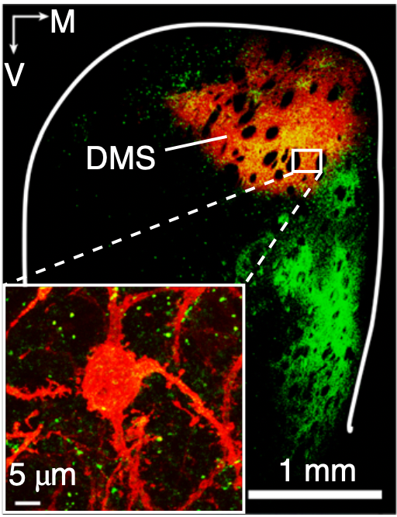
Bidirectional and long-lasting control of alcohol-seeking behavior by corticostriatal LTP and LTD
Ma et. al, 2018 | Wang Lab | Texas A&M
Presented by Ritika Raghavan

Slide 2
Overview
Introduction: Substance use disorder complexity and key players involved
Overarching Hypothesis
Results
Discussion
Pros and Cons
Questions

Slide 3
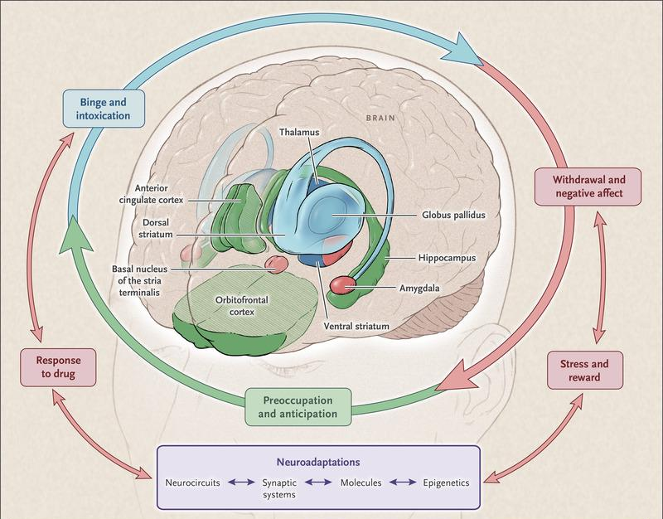
Substance Use Disorder arises from a complex combination of altered:
Emotional valence
Behavioral responses to stress and reward
Neuronal connectivity and neurotransmitter release involved circuits
Introduction | Results | Discussion | Questions
SUD onset
impulsive drug consumption
Binge intoxication episodes
Compulsive use of drugs
Drug evoked plasticity

Slide 4
How does synaptic plasticity control adaptive changes in drug-seeking behavior?
Introduction | Results | Discussion | Questions

Slide 5
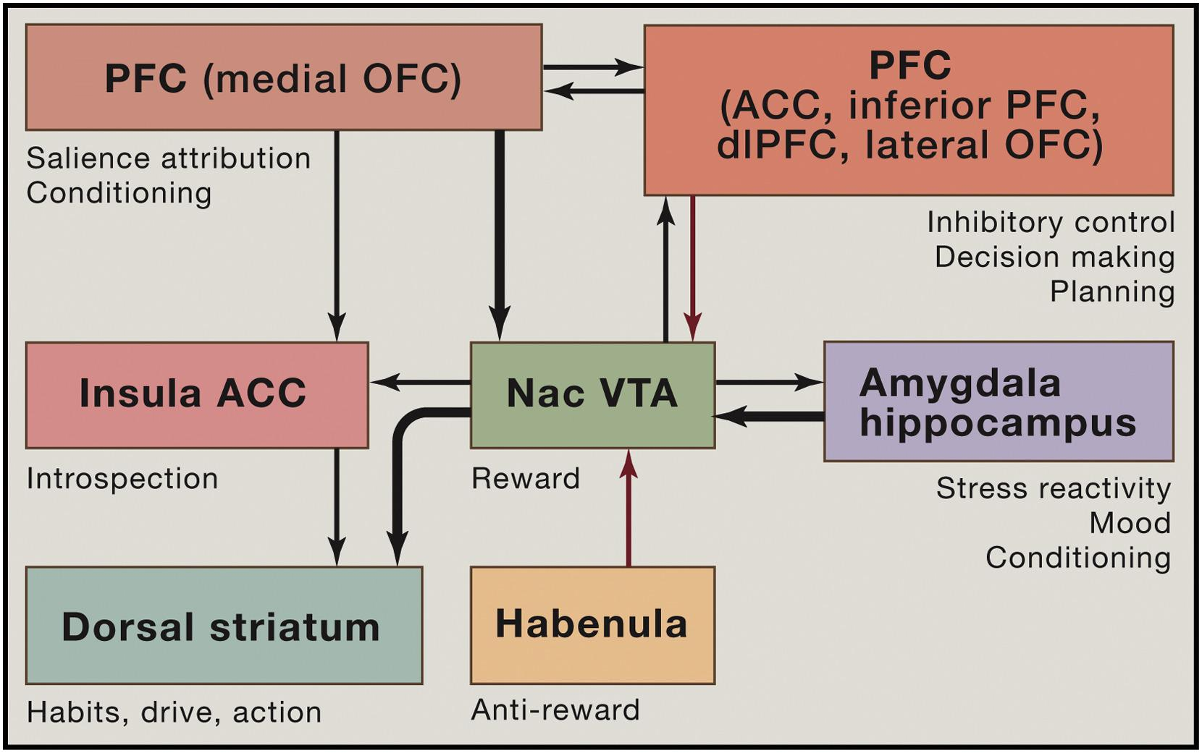
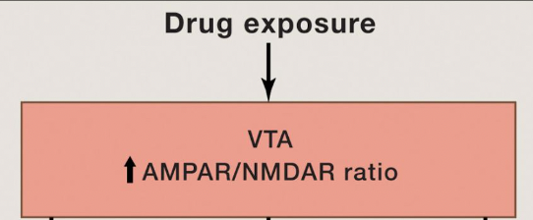
Introduction | Results | Discussion | Questions
Volkow and Morales, 2015

Slide 6
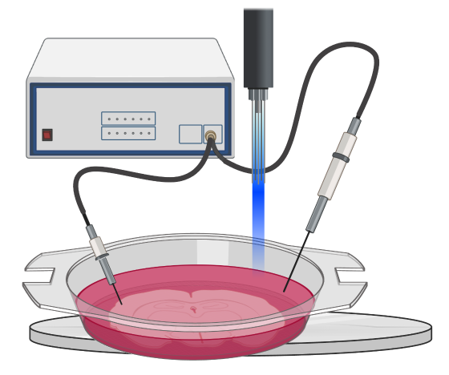
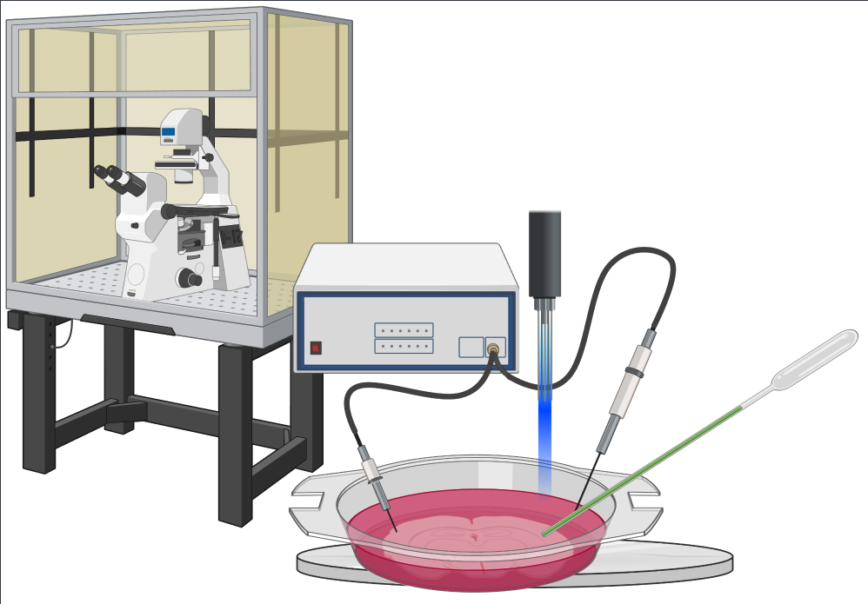
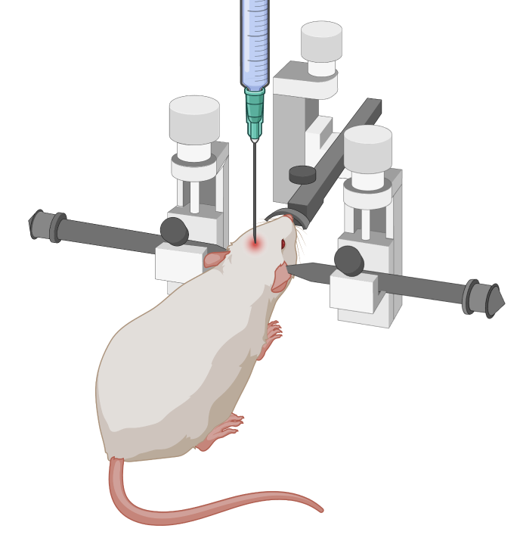
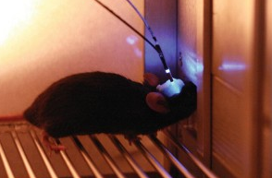
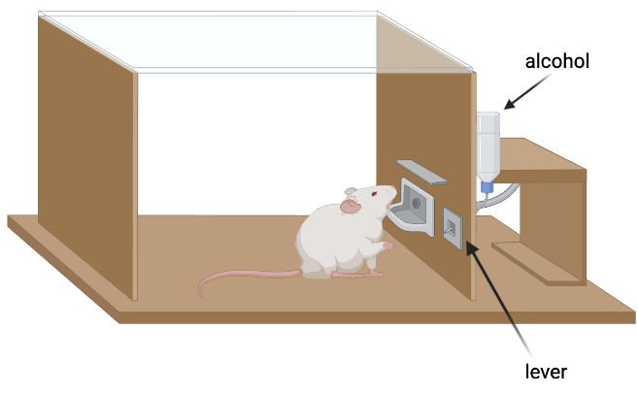
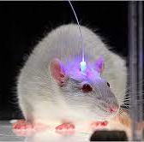
Channelrhodopsin strategies
Introduction | Results | Discussion | Questions
channelrhodopsin
OR
+

Slide 7
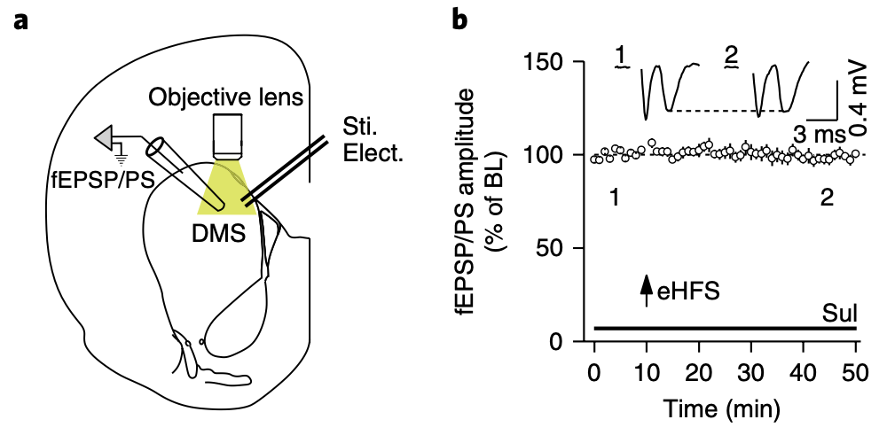
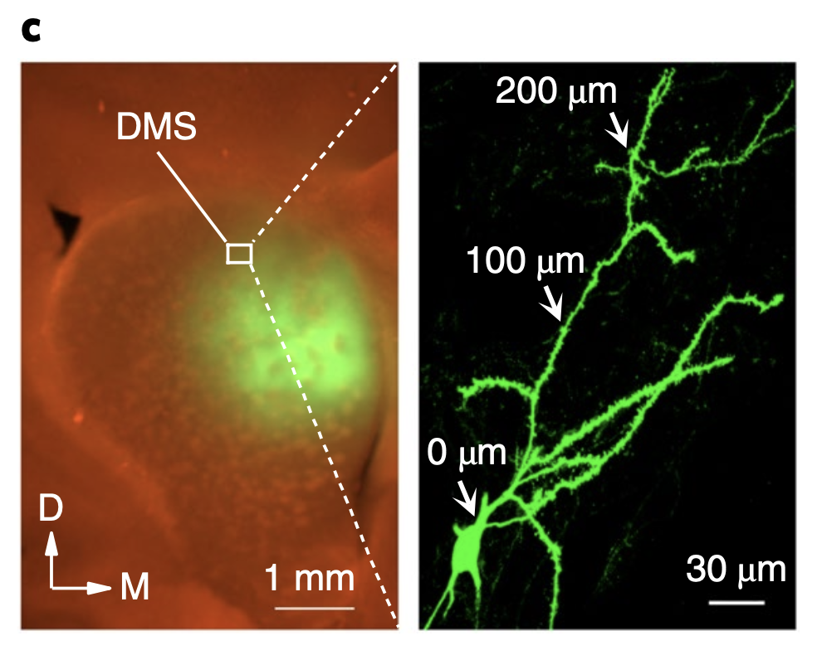
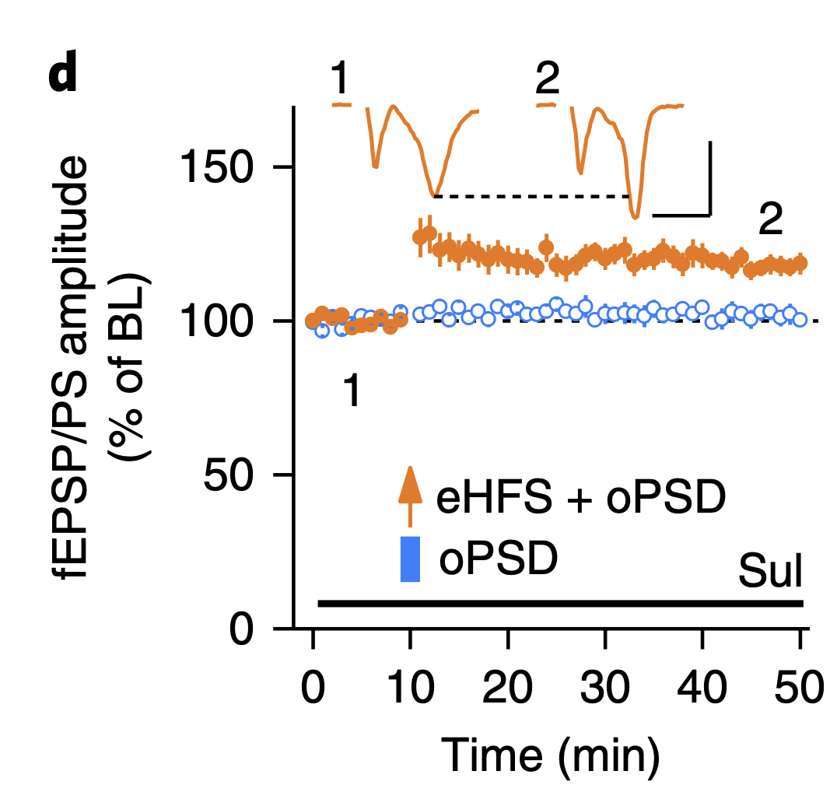
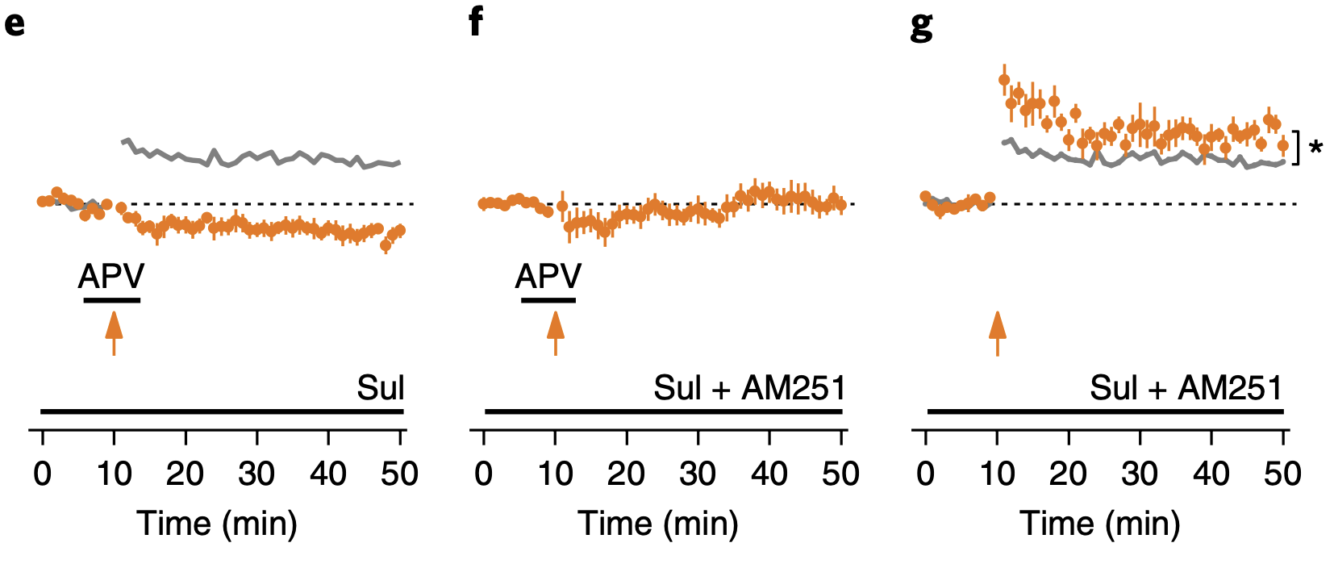
What drives synaptic plasticity in the DMS?
oPSD facilitates induction of NMDAR-dependent LTP and LTD in DMS in vitro
Introduction | Results (1) | Discussion | Questions
APV: NMDAR antagonist
AM251: CB1R antagonist

Slide 8

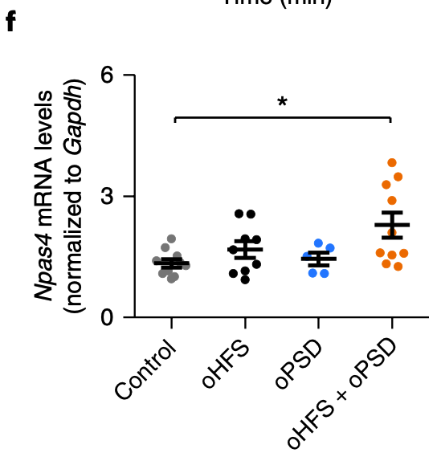
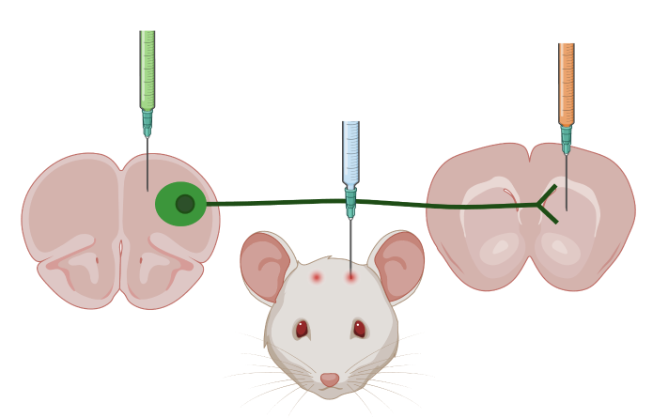
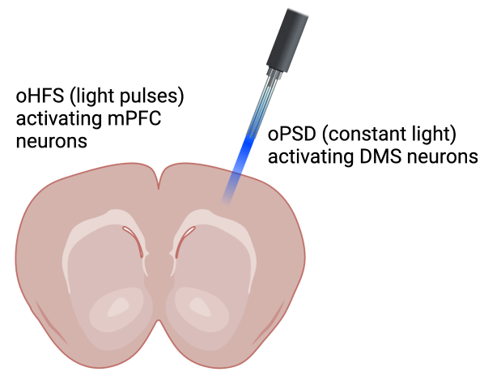
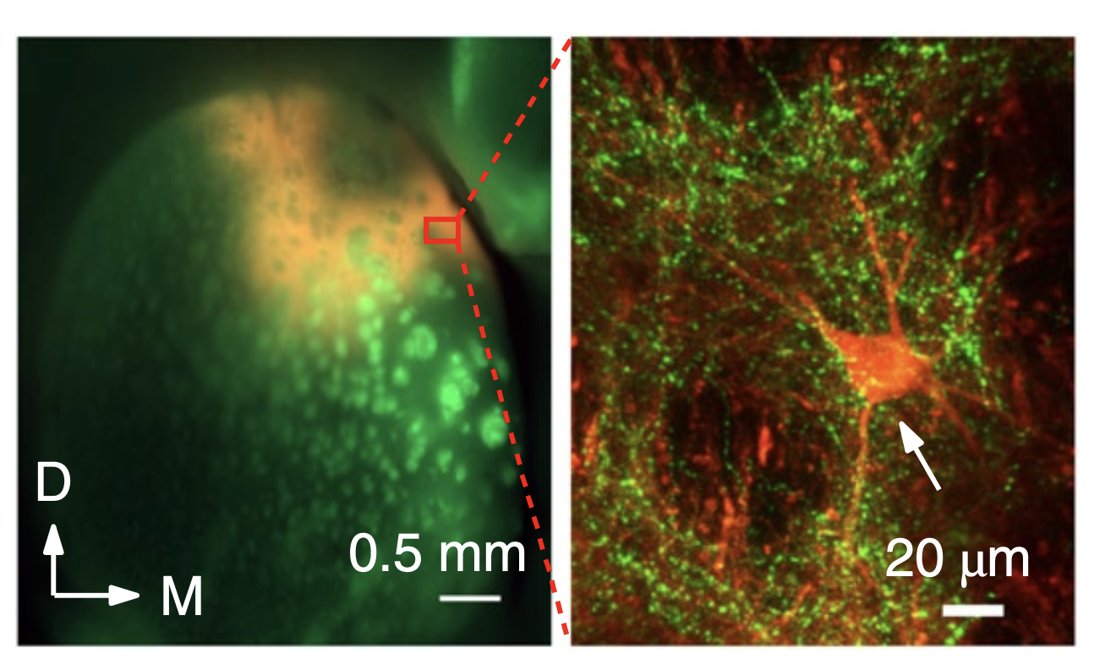
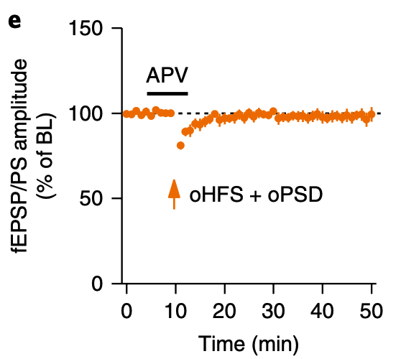
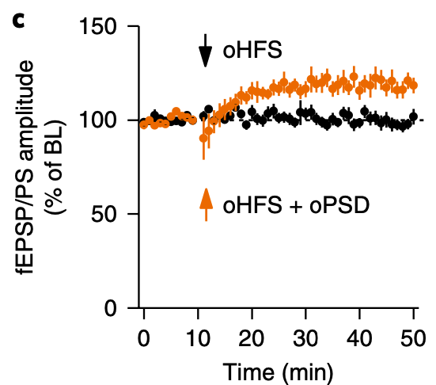
Can corticostriatal afferents drive synaptic plasticity in the DMS?
Introduction | Results (2) | Discussion | Questions
DMS
mPFC

Slide 9
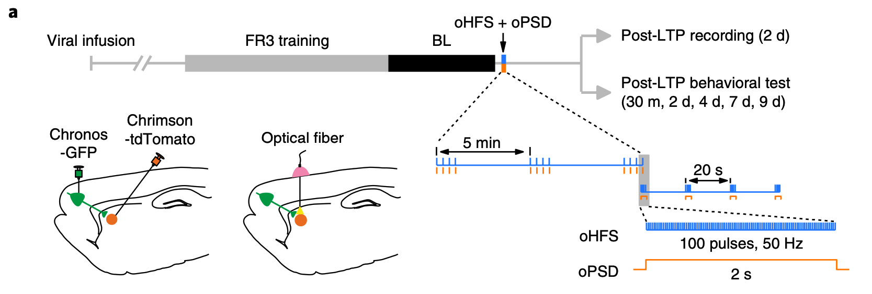
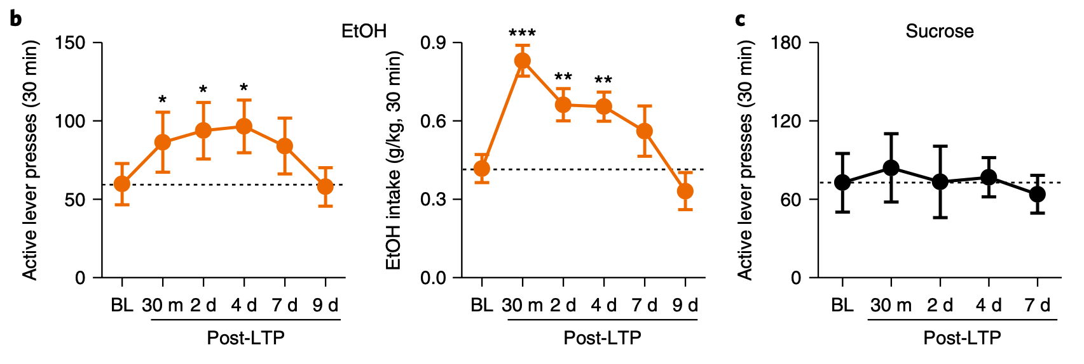
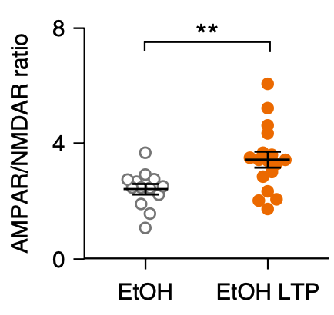
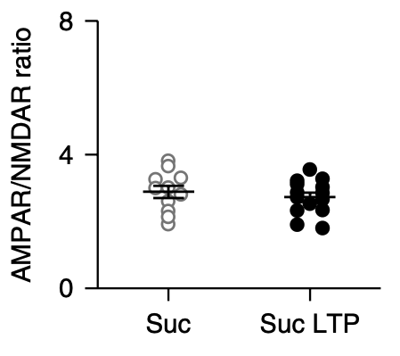
Introduction | Results (3) | Discussion | Questions
Can in vivo LTP induction alter alcohol seeking behavior?
In vivo LTP induction increased active lever presses and alcohol intake but nor sucrose intake
In vivo LTP induction increased AMPAR mediated excitatory drive and the AMPAR/NMDAR ratio for alcohol consuming rat cohort and failed to do so for sucrose consuming rat cohort

Slide 10
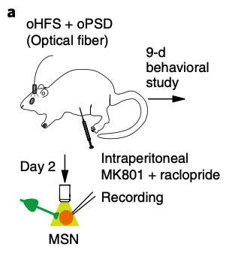
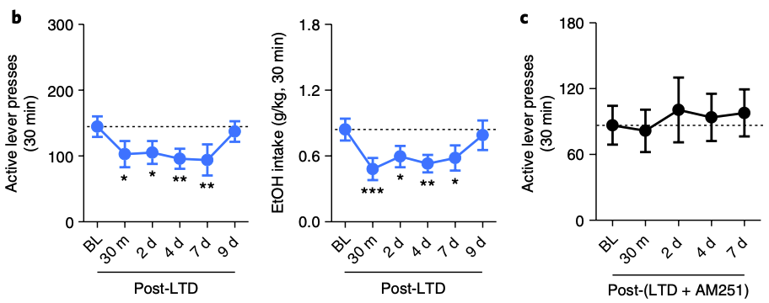
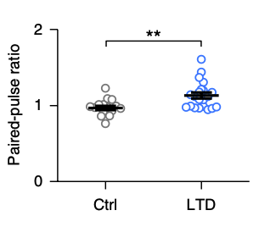
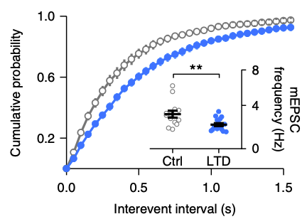
Introduction | Results (4) | Discussion | Questions
Can in vivo LTD induction suppress alcohol seeking behavior?
MK801: Dopamine D1R antagonist
raclopride: Dopamine D2R antagonist
AM251: eCB CB1R antagonist
LTD induced rats show lesser lever presses, lesser alcohol intake which is abolished by eCB CB1R antagonist treatment
LTD induced rats show lower paired pulse ratio and less frequent spontaneous miniature excitatory currents all indicating synaptic depression

Slide 11
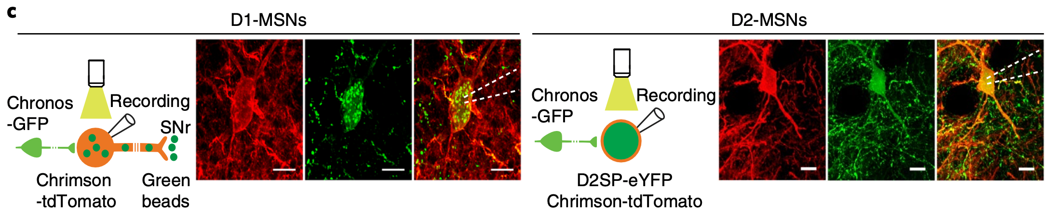
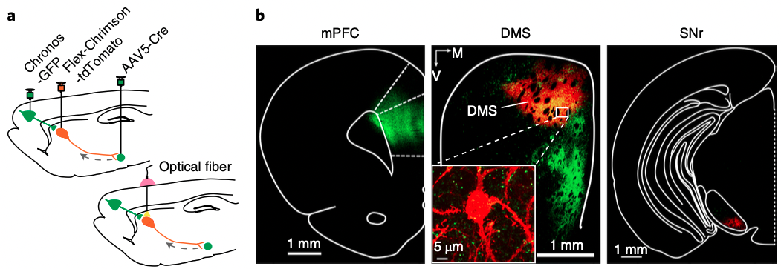
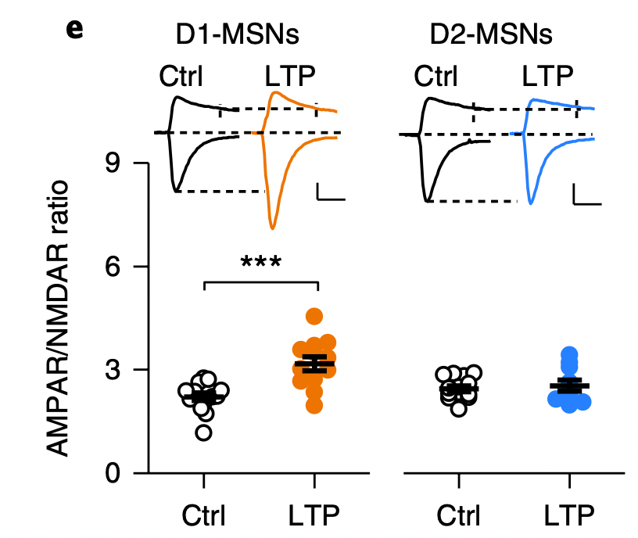
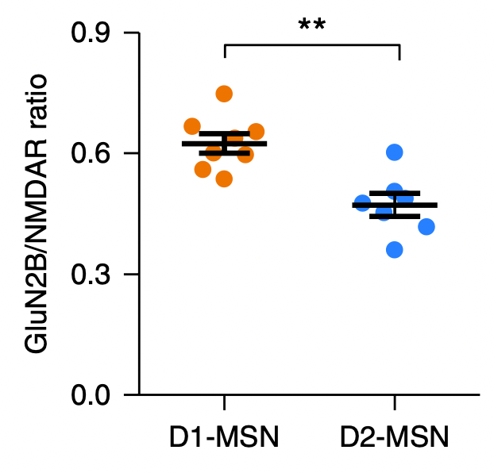
Introduction | Results (5) | Discussion | Questions
How does LTP induction alter glutamatergic transmission in MSN in the DMS addiction circuit?
D1-MSNs were labelled by retrograde beads in the substantia nigra pars reticulata
D2-MSNs were labelled with a AAV-D2SP-eYFP
D1-MSNs showed higher AMPAR/NMDA ratio upon LTP induction which could be driven by higher GLUN2B/NMDA ratio

Slide 12
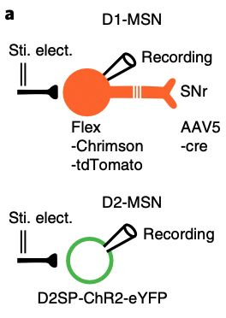
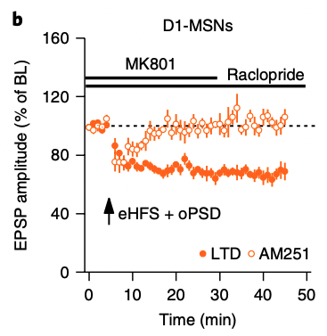
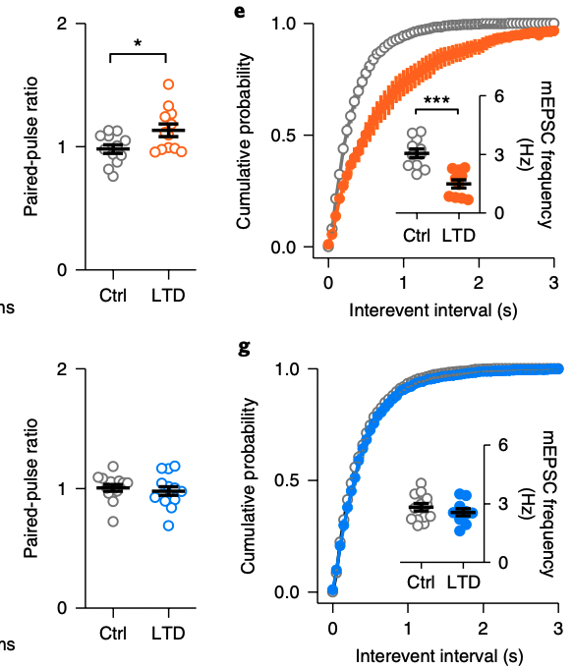
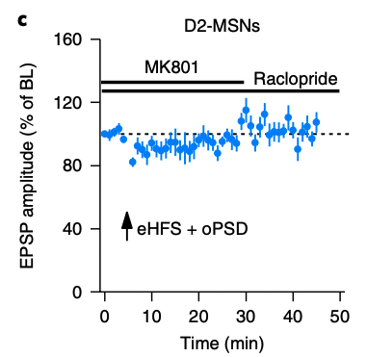
Introduction | Results (6) | Discussion | Questions
How does LTD induction alter glutamatergic transmission in MSN in the DMS addiction circuit?
eHFS + oPSD + MK801(D1R agonist) + raclopride(D2R agonist)
AM251: CB1R antagonist

Slide 13
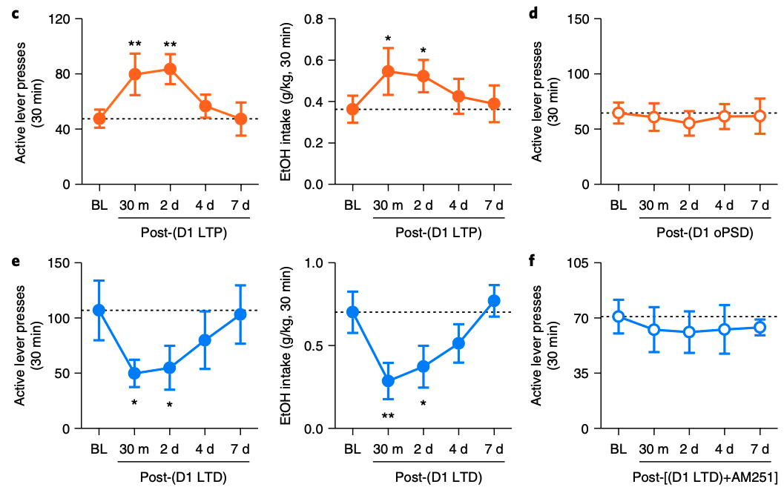
Introduction | Results (7) | Discussion | Questions
Does in vivo induction of corticostriatal LTP or LTD DMS D1-MSNs alter alcohol-seeking behavior?
LTP induction resulted in alcohol seeking mice to press levers more frequently which was correlated with ethanol intake. This effect was not observed when they received only oPSD treatment
LTD induction resulted in alcohol seeking mice to press levers less frequently correlated to less ethanol intake which was abolished upon AM251 treatment.

Slide 14
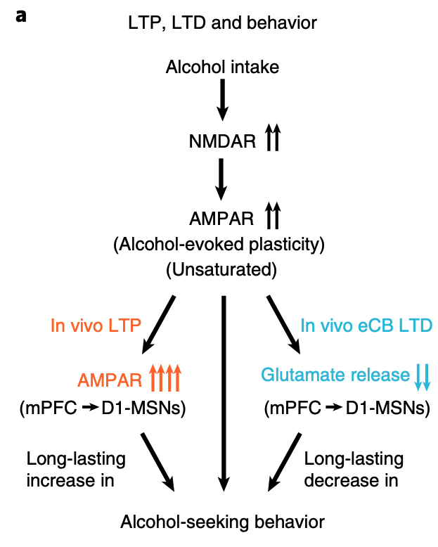
Summary
Introduction | Results | Discussion | Questions
Alcohol intake facilitates NMDAR activity leading to potentiation of AMPAR activity
Further potentiation occurs by in vivo LTP induction at mPFC afferents into the DMS D1-MSNs which results in long lasing increase in alcohol seeking behavior
In vivo LTD induction the same synapses can result in long-lasting suppression of this behavior

Slide 15
Pros
Introduction | Results | Discussion | Questions
Cons
Utilized both ex vivo and in vivo approaches to study LTP and the resulting behavior change
Excellent use of viral tracing strategies paired with optogenetics
Utilized both LTP and LTD induction approaches to look at effects to found a novel therapeutic result (!)
Did not use a NMDAR agonist or CB1R antagonist to see if LTP effect is enhanced
Results are doubtful since both the presynaptic and post-synaptic terminals are being activated
Would have liked to measure more IEG expression (such as IHC in slices).
Would have liked to see expansion of eCB related results, such as measuring anandamide levels

Slide 16
Discussion Questions
Introduction | Results | Discussion | Questions
The authors posit a novel therapeutic approach via LTD induction in wake behaving animals to combat alcohol seeking behavior. How could this approach be translated to clinical studies in human patients?
Can a disease as complex as addiction (the presentation and diagnosis of which is driven by multiple factors such as family history, other mental illnesses, environmental stress load, exposure to substances etc.) be recapitulated in simpler organisms in a controlled condition?
The time duration for the behavioral changes to alter for mice in this study was 7d. How can we begin to translate this for addiction patients who tend to relapse even after a withdrawal period of many years?

Slide 17
Thank you!

